Slide 1

Elastic Search For Dot Net Developers
By
David Betteridge
@da_betteridge
Notes:
I’ve worked in the software industry for the past 20 years, coding in C# and using Microsoft’s SQL Server for storage
Recently we’ve been looking at other solutions such as Elastic Search in order to solve some of our performance issues.

Slide 2

Tonight
Notes:
Tonight we will be looking
What issues do we have with SQLServer which we like to solve
What is elastic search
How do we get started / install/query
Does it solve our problems

Slide 3
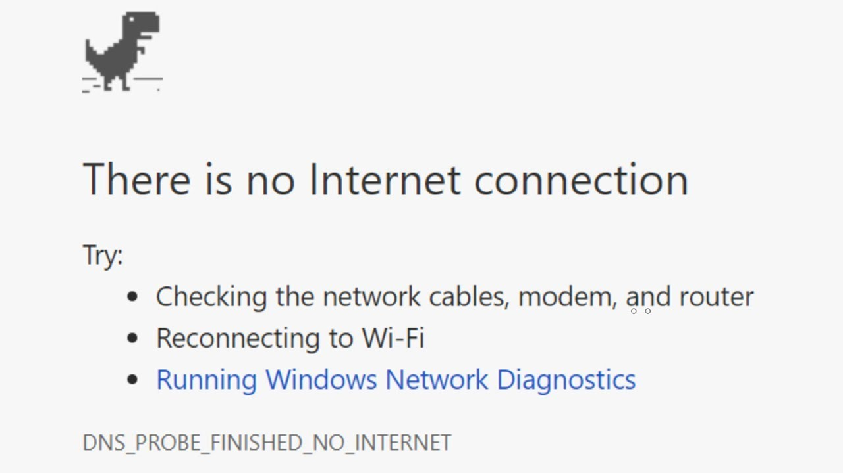


Requirement
Notes:
So you are some coding, getting stuck as usual which requires you to use google and stackoverflow to find various answers
However, then disaster strikes, you lose your internet connection
You can no longer use stack overflow.

Slide 4
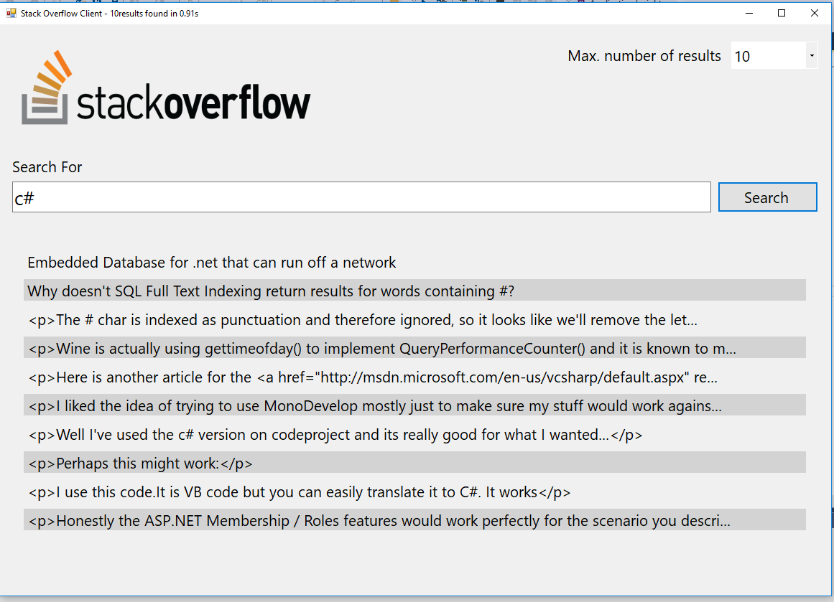
The Application
Notes:
To enable you to work offline I’ve download a SQLServer database containing 10GB of questions + answers
And written an windows form application in order to query it.
Demo application

Slide 5
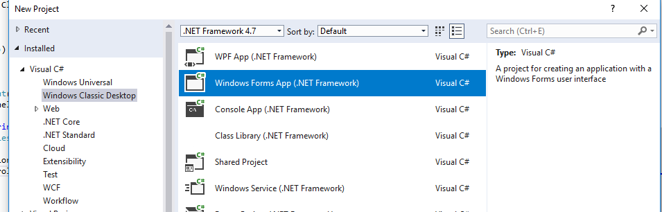

Architecture
Notes:
Look at the database in SSMS (StackOverflow2010)
Point out the size and main tables (Posts and Comments)
Our tables just have indexes on the ID
Do count(*) to get the number of rows
select rowcnt from sysindexes where OBJECT_NAME(id) = 'Posts'
select rowcnt from sysindexes where OBJECT_NAME(id) = 'Comments’
Show that without any indexes, querying the data will be very slow
select top 10 *
from dbo.Posts
where LastEditorDisplayName = 'David’
Estimated Query shows that every row will be examined (clustered index scan)
We could create indexes, but on which columns, as we might want to search by any of them.
Even then we can’t create an index on the main content field.
select top 10 *
from dbo.Posts P
where lower(P.Body) like 'c%’
We want to do a case-insensisitve search so need to convert ever thing to lower case. Also indexes can’t be used with do are doing a %wild card search
We could use full text search in SQLServer, but it’s limited in features and performance.
Finally, scale, the full stack overflow database is over 130GB, without any indexes. You can split sql server over multiple database but there are complications.

Slide 6

Problems
Notes:
So to summarise, we have three problems
The ability to be able to search across multiple fields
The ability to be able to search within a block of text
The ability to scale out across multiple machines

Slide 7
Introducing Elastic Search
Elasticsearch is an open-source, broadly-distributable, readily-scalable, enterprise-grade search engine.
Accessible through an extensive and elaborate API, Elasticsearch can power extremely fast searches that support your data discovery applications.
Notes:
Getting started
Inverted Index
Rest API
NEST API
Bulk Import
Demo adding data
Demo search for data

Slide 8

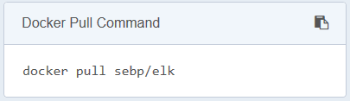
Getting Started
Notes:
This starts running
Elastic Search
Log Stash (5044)
And Kibana (5601)
We will just look at Elastic Search for the moment.
Show http://localhost:9200/
We can see the version number and basic cluster info.
Elastic Search is built on top of lucence.
Communication can be done via REST calls, for example to view the health of our 1 node cluster
http://localhost:9200/_cluster/health
Stemming etc

Slide 9
Creating a Document
Defining Indexes
Notes:
Describe index type and id
Index/type/id id is optional
Result is created, then updated
The version number also goes up

Slide 10
Security
xpack

Slide 11
Scaling - Distributed

Slide 12
Logs
Log Stash
Kibana
Beats
DEMO

